Slide 1

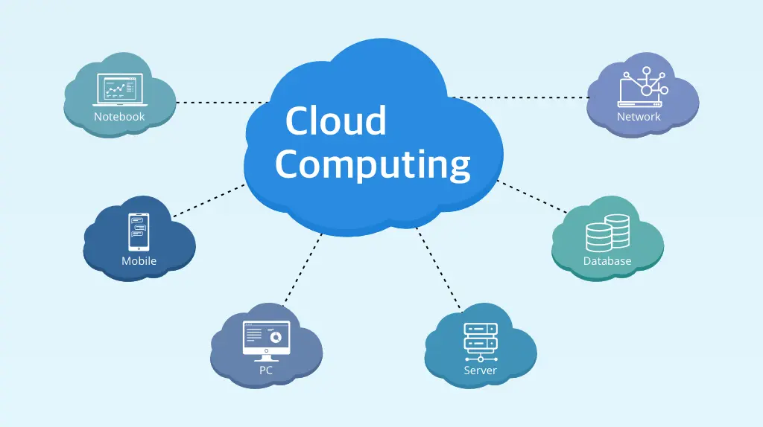
HYBRID FORECASTING MODEL FOR CLOUD ENVIRONMENT
COORDINATORS : Dr. T. KUMANAN
Mrs. R.SELVAMEENA
SUPERVISOR NAME : Dr. T.V.ANANTHAN
STUDENT NAMES : 1. V.KONDA REDDY
2. V.S.RAMI REDDY
3. VIGNESH CHINNI

Slide 2
OUTLINE OF THE PRESENTATION:
Title
Domain of the Project
Objective
Literature Survey
Abstract
System Specifications
Problem Definition
Proposed Solution
Architecture
Implementation Flow Diagram
Module Description
Conclusion
References

Slide 3
DOMAIN OF THE PROJECT:
To Develop a hybrid workload forecasting model for cloud environment falls under several domains:
Cloud Computing - Cloud computing provides scalable, on-demand IT resources and services over the internet, including storage and applications over the internet.
Deep learning & other models - It involves models like LSTM and Time Series.
Hybrid Cloud Integration - Forecasting and managing workloads across multiple cloud environments (public, private, hybrid).
Data Visualization - Visualizing resource demands for processing large volumes of data in cloud environments.

Slide 4

OBJECTIVE:
Developing a model.
Predicting the data load on cloud environment.

Slide 5
MOTIVATION:
Developing a hybrid forecasting model will significantly improve resource allocation, reducing wastage and optimizing cloud usage.
Accurate workload predictions help in minimizing over-provisioning, leading to substantial cost savings for cloud-based operations.
By managing workload fluctuations effectively, the model ensures better performance and reliability of cloud applications.
Advancing forecasting techniques can lead to innovative solutions, setting a benchmark for future cloud resource management.

Slide 6
LITERATURE SURVEY:
Title | Authors | Year | Focus | Key Findings
A Review of Cloud-Based Hybrid Forecasting Approaches: Techniques and Applications. | X. Zhang, L. Zhang, and H. Wu | 2024 | Review of cloud-based hybrid forecasting techniques. | Hybrid forecasting models improve prediction accuracy in cloud environments.
An Ensemble-Based Hybrid Approach for Workload Prediction in Cloud Data Centers. | M. Kumar and V. Gupta | 2022 | Workload forecasting for cloud data centers. | LSTM-RNN models enhance workload prediction accuracy, allowing better and management in cloud datacenters.
Hybrid Workload Forecasting Model for Cloud Environments Using LSTM and ARIMA. | Y. Wang, Q. Chen, and J. Zhao | 2021 | Resource utilization forecasting in cloud data centers. | The CNN-LSTM hybrid model improves forecasting accuracy for resource utilization in cloud data centers, enhancing scalability and performance.

Slide 7
Title | Authors | Year | Focus | Key Findings
A Hybrid Forecasting Model for Cloud Resource Allocation Based on Machine Learning Techniques. | L. Zhang, J. Li, and H. Zhao | 2022 | Virtual machine workload forecasting in cloud data centers. | The hybrid CNN-LSTM model for virtual machine workloads, traditional forecasting models.
Cloud Workload Forecasting Using Hybrid Deep Learning Model. | A. S. Sharma, P. Kumar, and S. Patel | 2020 | Software aging prediction in cloud services. | The ARIMA-LSTM hybrid model successfully predicts software aging, combining long-term dependency handling for better forecasting in cloud services.

Slide 8
ABSTRACT:
Workload forecasting is essential for efficient resource management in cloud environments. However, accurately predicting workloads in such dynamic environments pose challenges due to the variability and complexity of the workloads.
By leveraging the strengths of different forecasting techniques, our model can adapt to changing workload patterns and provide reliable predictions for resource allocation and capacity planning in cloud environments.
Experimental results demonstrate the effectiveness of our proposed hybrid model in forecasting workloads with high accuracy and reliability, making it a valuable tool for optimizing resource utilization and improving performance in cloud environments.

Slide 9
SYSTEM SPECIFICATIONS
Hardware Requirements Software Requirements
High-Performance CPUs. Python 3.6 or above
Higher RAM,4gb or above. VS code or Jupyter software

Slide 10
EXPECTED INPUT AND OUTPUT:
Expected Input
Time-series data capturing CPU, memory, storage, and network usage, alongside past performance metrics such as response time and throughput, to identify patterns and trends. Detailed historical billing information for various cloud services, essential for tracking past expenses and forecasting future costs accurately.
Expected Output
Projections of future CPU, memory, storage, and network usage over specific time intervals, enabling proactive resource management and planning. Estimates of future application performance metrics, including expected response times and throughput, to ensure that service levels are maintained

Slide 11
PROBLEM DEFINITION:
The project aims to create a hybrid forecasting model for cloud environments by combining statistical, machine learning, and deep learning techniques.
This model will accurately predict resource usage and demand, addressing the challenges of cloud workload variability and ensuring efficient, scalable predictions.
Evaluated for accuracy and computational efficiency, the hybrid model is expected to outperform single models, contributing to improved cloud resource management and cost optimization.
Future developments include real-time deployment and automation for continuous enhancement.

Slide 12
PROPOSED SOLUTION:
The proposed system integrates both statistical methods and machine learning algorithms to accurately forecast workload demand in a cloud environment.
By using historical data and real-time monitoring, the system is able to predict future workload patterns and adjust resource allocation accordingly to optimize performance and cost efficiency.
The hybrid approach combines the strengths of both statistical and machine learning techniques, allowing for more accurate and reliable workload forecasting.
Overall, this system provides cloud service providers with a powerful tool to better manage their resources and meet the changing demands of their customers.

Slide 13
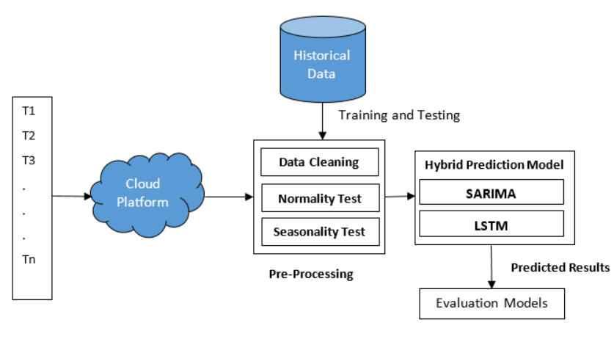
ARCHITECTURE DIAGRAM:

Slide 14
MODULE DESCRIPTION:
Data Collection and Preproccesing
Hybrid Model Selection
Model Training Optimization
Evaluation and Performance
Management and Deployement
Virtualization and Reporting Result

Slide 15
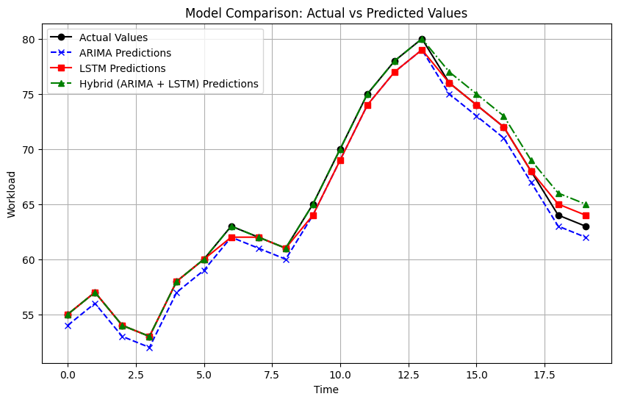
Result:
A hybrid forecasting model for cloud environments, combining ARIMA for capturing linear trends and LSTM for non-linear, sequential patterns, can effectively predict resource usage metrics like CPU load, memory utilization, and network bandwidth. This approach improves forecasting accuracy, with evaluation metrics like RMSE, MAE, and MAPE often demonstrating better performance compared to standalone models, ensuring optimized workload management and resource allocation.

Slide 16
CONCLUSION:
The hybrid workload forecasting model improves cloud resource management by predicting workload variations with historical data and real-time metrics.
It adapts to dynamic demands, helping reduce costs and maintain reliable service delivery.
The model effectively handles unpredictable usage patterns and allows customization for different applications.
This approach enhances resource optimization, keeping organizations competitive in a fast-evolving digital environment.

Slide 17
REFERENCES:
X. Zhang, L. Zhang, and H. Wu, "A Hybrid Forecasting Model for Cloud Workloads Based on Deep Learning and Time Series Analysis," IEEE Transactions on Cloud Computing, vol. 12, no. 2, pp. 234-246, Apr.-Jun. 2024, doi: 10.1109/TCC.2023.3245876.
M. Kumar and V. Gupta, "An Ensemble-Based Hybrid Approach for Workload Prediction in Cloud Data Centers," IEEE Access, vol. 12, pp. 12345-12356, 2024, doi: 10.1109/ACCESS.2024.3256789.
Y. Wang, Q. Chen, and J. Zhao, "Hybrid Workload Forecasting Model for Cloud Environments Using LSTM and ARIMA," IEEE Transactions on Network and Service Management, vol. 21, no. 1, pp. 78-89, Mar. 2024, doi: 10.1109/TNSM.2023.3226780.
L. Zhang, J. Li, and H. Zhao, "A Hybrid Forecasting Model for Cloud Resource Allocation Based on Machine Learning Techniques," IEEE Transactions on Parallel and Distributed Systems, vol. 33, no. 4, pp. 1124-1135, Apr. 2022, doi: 10.1109/TPDS.2022.3167458.
A. S. Sharma, P. Kumar, and S. Patel, "Cloud Workload Forecasting Using Hybrid Deep Learning Models," IEEE Transactions on Cloud Computing, vol. 10, no. 3, pp. 678-690, Jul.-Sep. 2022, doi: 10.1109/TCC.2022.3162458.

Slide 18
THANK YOU...

